Slide 1





Workflow, Build Profiles and Push Profiles for Simulators and Devices Windows (Android)
Fauzi Sholichin
fauzisholih@gmail.com
+6289673732142
https://www.linkedin.com/in/fauzisho/

Slide 2
Introduction
Preparing Emulator or devices
Adding the platform to the project
Checking the project requirements
Building Profiles and Push Profiles (Deployed to emulator or device)

Slide 3
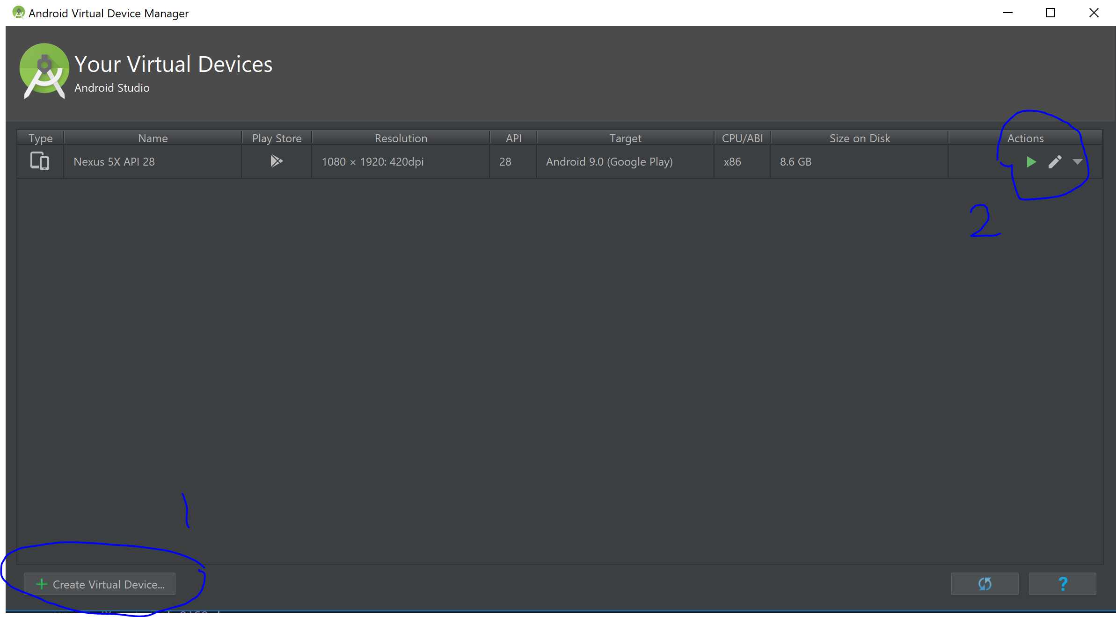
Preparing emulator (GUI)
Open an Android Studio Project
Select Tools > AVD Manager
Create a new emulator
Launch emulator

Slide 4
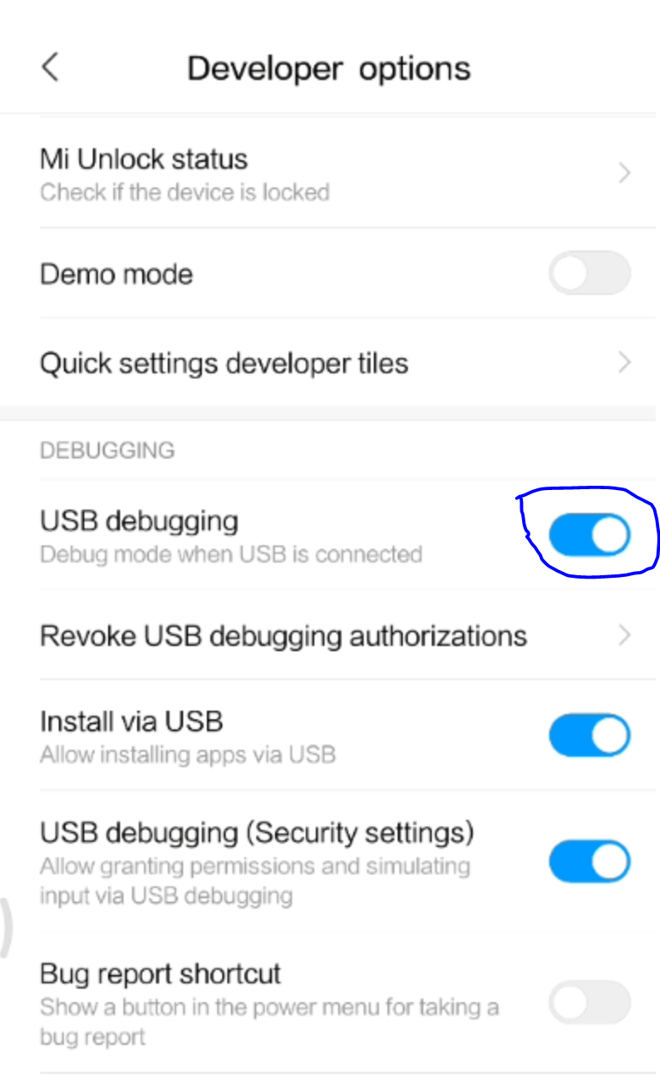
Preparing device
Device dependant
Normal process
Open phone
Navigate to
Settings > About phone > Build number
Enable developer options
Enable USB Debugging

Slide 5
Open CMD or Powershell and navigate to project directory
Open Explorer and navigate to the project
Shift + right-click
Choose ‘open command window here’ or ‘open powershell window here’
For advanced user (windows 8 and later)
Press Window + X
Press A
Cd <project_directory>

Slide 6
The following step will be in a command window
ionic integrations enable cordova
ionic cordova platform add android
ionic cordova requirements
Ionic emulate android / ionic run android

Slide 7
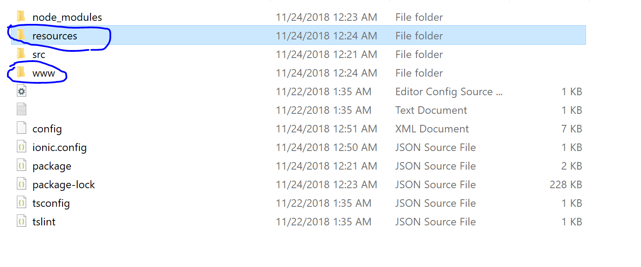
Command: ionic integrations enable cordova
To enable ionic-cordova, a framework to allow html, css and js to be run natively on devices.
More details and refer to https://cordova.apache.org/
Two folder will be added

Slide 8
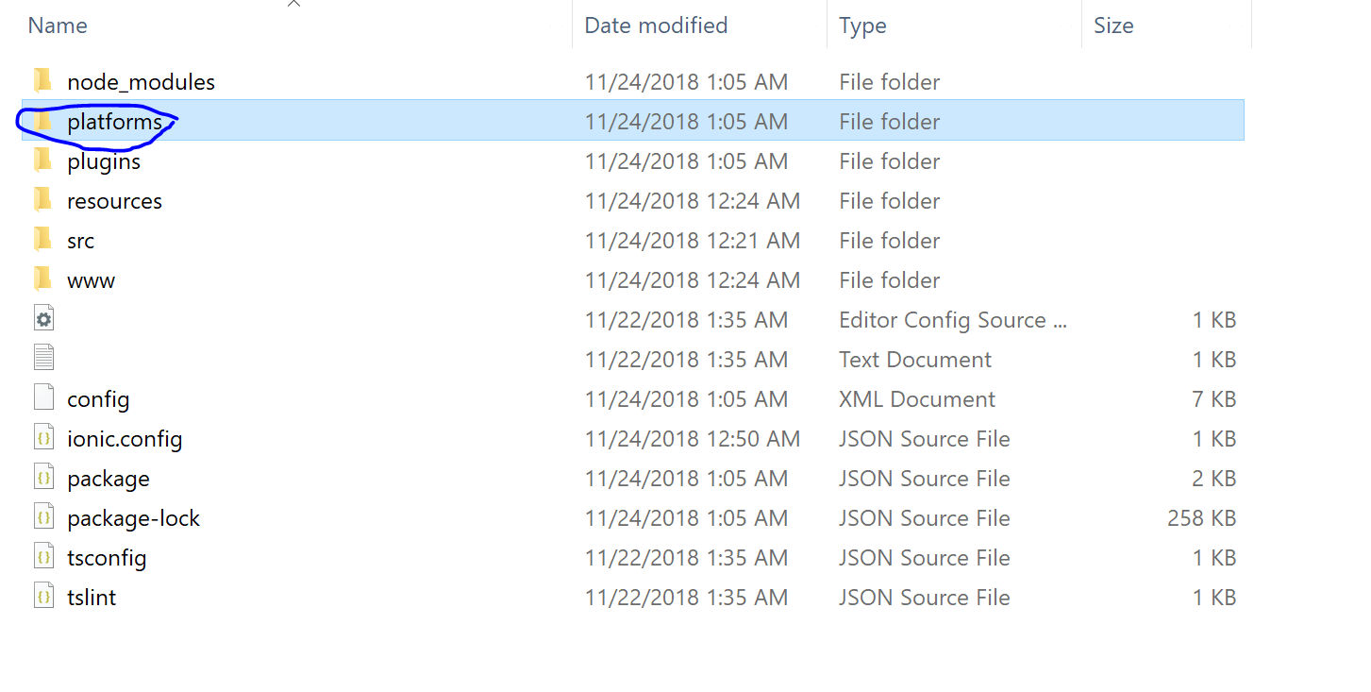
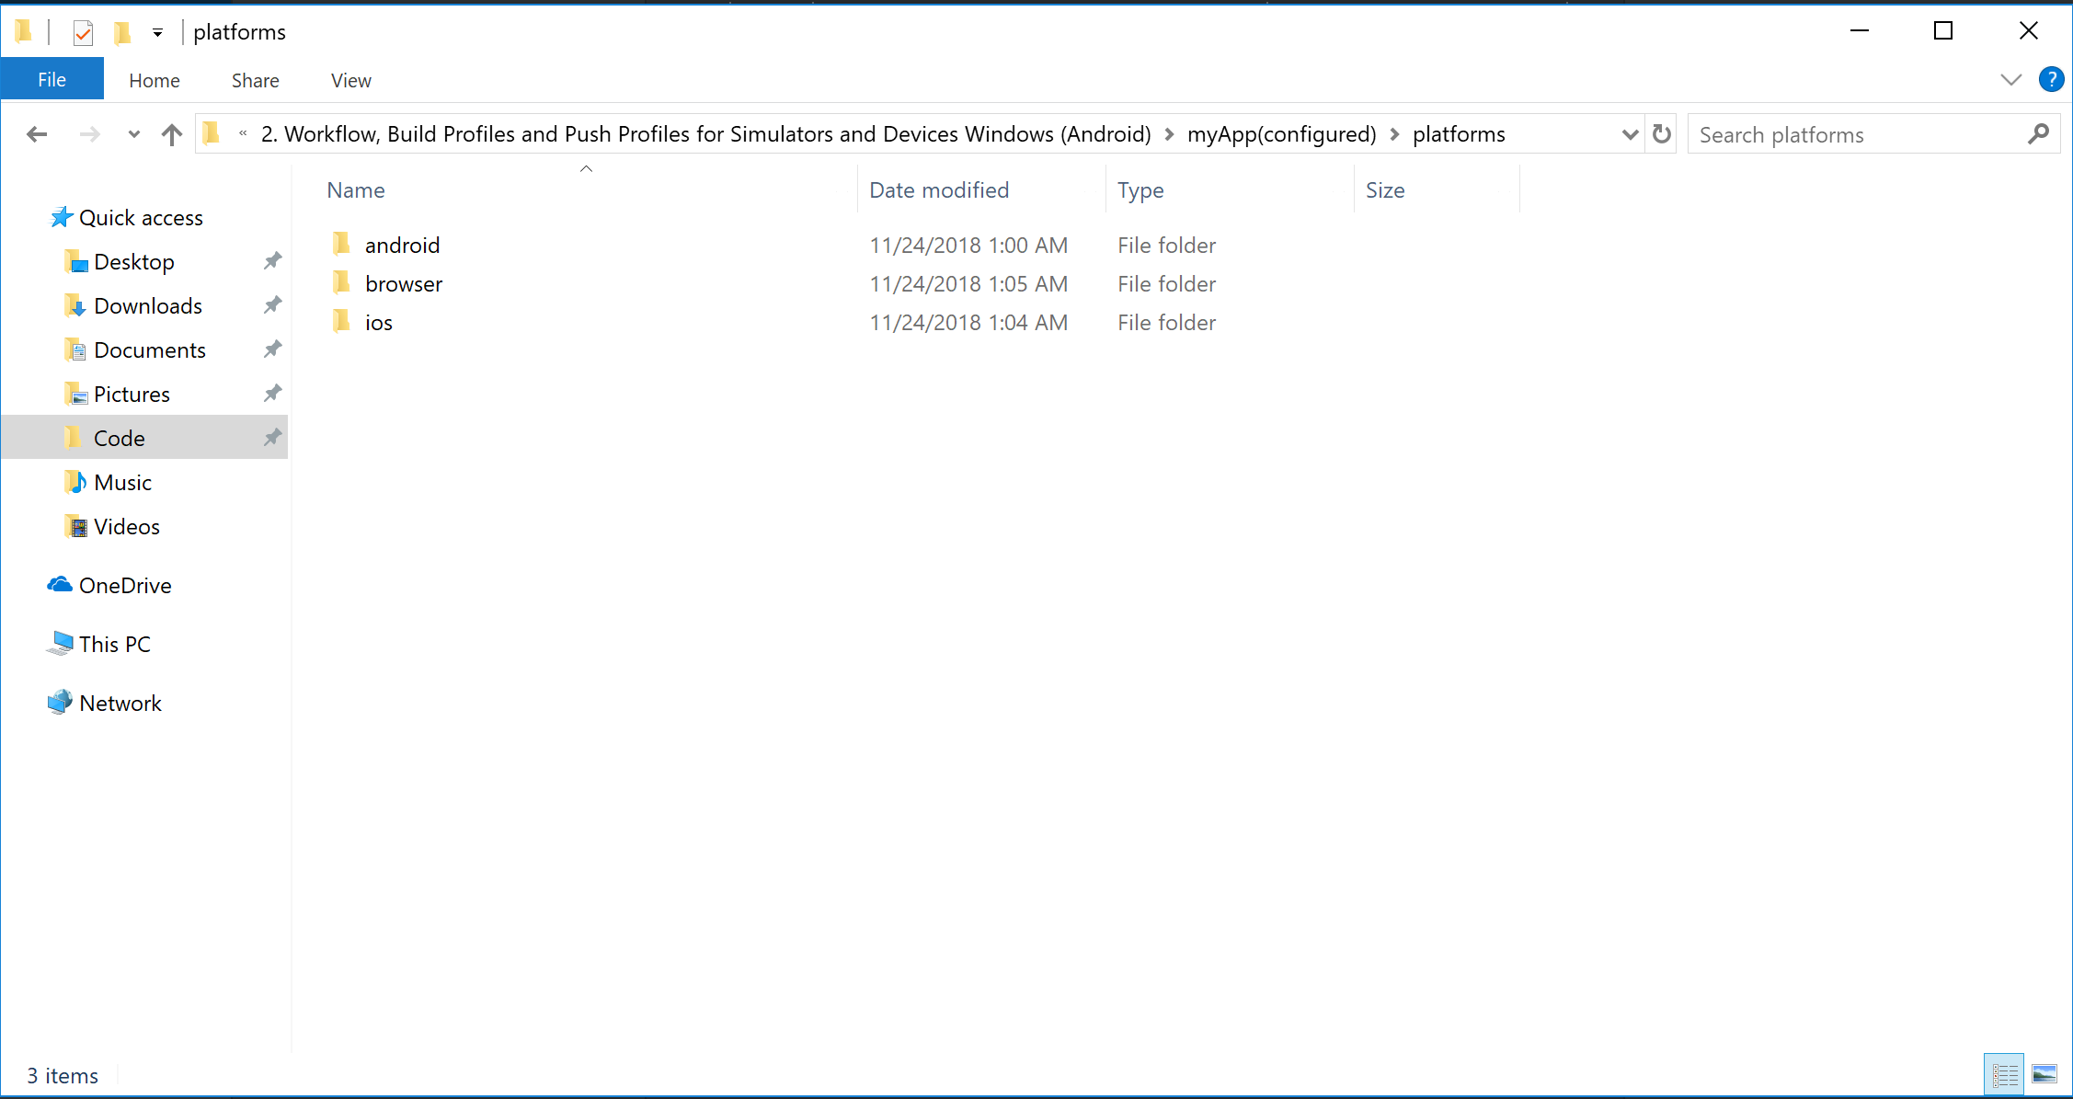
Command: ionic platform add <platform>
Android
IOS
Browser
OSX
Windows

Slide 9
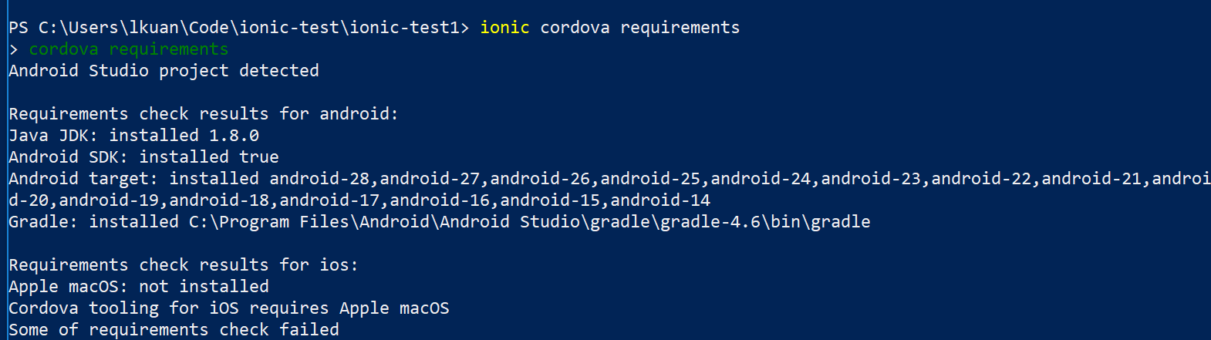
Command: ionic cordova requirements
Check for requirements to build the project

Slide 10
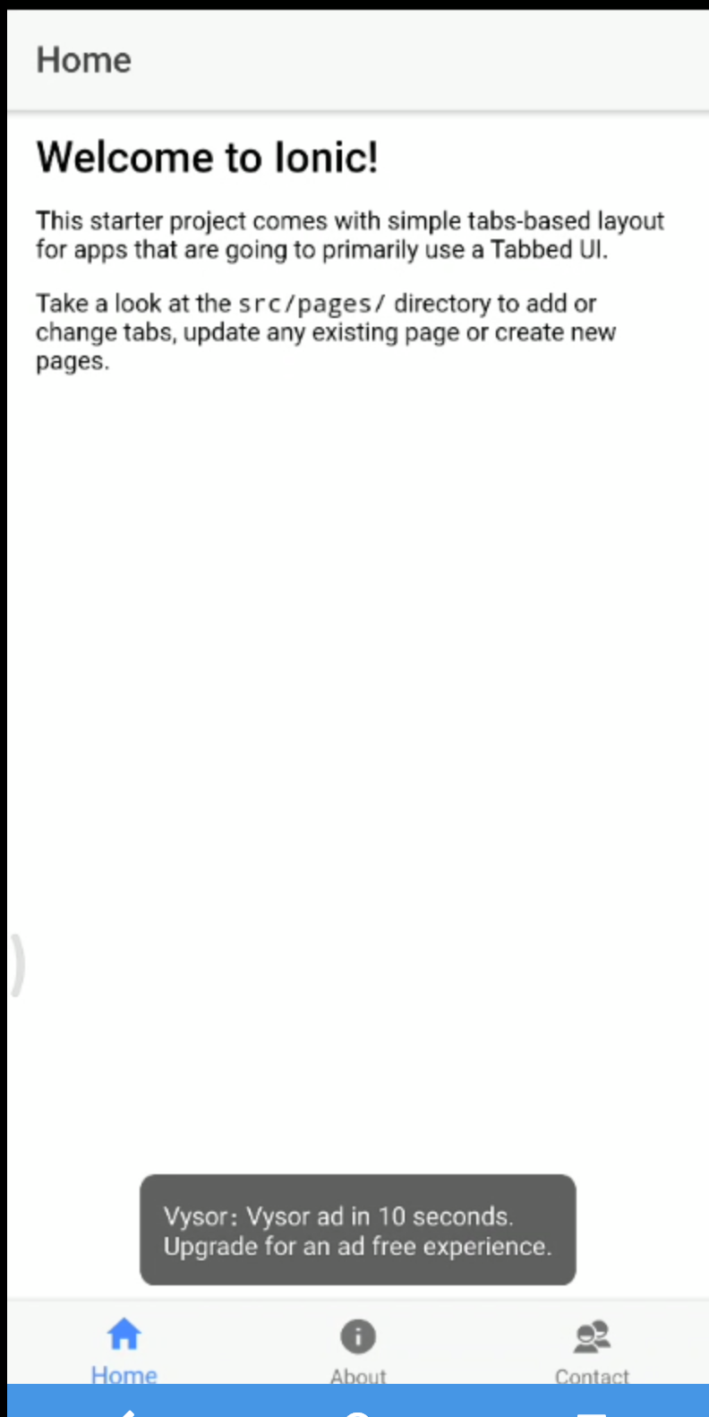
Command: ionic emulate android / ionic run android
Build and push profile to device and emulator
Running on a device

